Slide 1
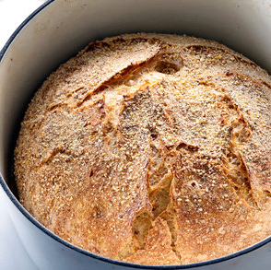
Predicting the Number of Recipe Ratings Madeline Vossbrinck
T
Cooking

Slide 2

Outline
Background and Data
Features and Methodology
Results
Conclusions and Future Work

Slide 3
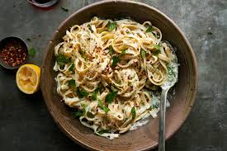
Background
A recipe’s number of ratings can be used as a measure of user engagement. The ratings themselves offer valuable feedback to both the recipe’s author and NYT Cooking.

Slide 4
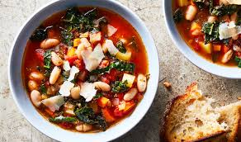
Data
NYT Cooking - https://cooking.nytimes.com
Wayback Machine - https://archive.org
Tools
BeautifulSoup
Selenium
Extruct

Slide 5
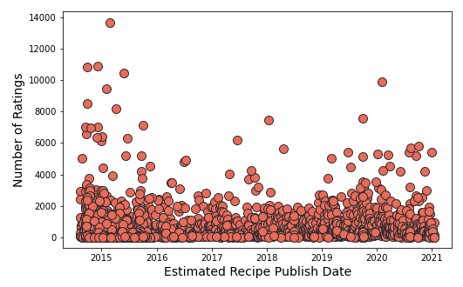
Number of Ratings by Estimated Publish Date
Value Summary:
Min | 0
25th | 15
50th | 103
75th | 402
Max | 13,705
Mean | 395

Slide 6
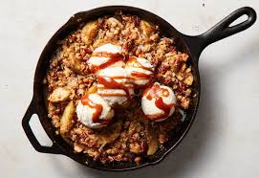
Features Considered
Number of Preparation Steps
Aggregate Rating Value (1-5)
Preparation Time (minutes)
Number of Ingredients
Days Since Estimated Publish Date
Keyword Tags (main course, easy, vegetarian, etc.)
Author (Melissa Clark, Mark Bittman, etc.)

Slide 7
Categorizing Authors
Author | Total Ratings | Recipe Count | Average #
Melissa Clark | 183448 | 271 | 676.9
Mark Bittman | 116898 | 249 | 469.5
Sam Sifton | 74158 | 76 | 975.8
David Tanis | 63287 | 147 | 430.5
Alison Roman | 61910 | 43 | 1439.8
Ali Slagle | 61533 | 41 | 1500.8
Julia Moskin | 61022 | 84 | 726.5
Martha Rose Schulman | 36808 | 192 | 191.7
Colu Henry | 28090 | 27 | 1040.4
The New York Times | 27596 | 25 | 1103.8
There is a drop in total ratings after Julia Moskin

Slide 8
Selected Model
Predicted Number of Ratings =
343.8 * Aggregated Rating Value + 0.083 * Recipe Time In Minutes
- 0.225 * Days Since Estimated Publish Date
+ 975.9 * Author Is Ali Slagle + 916.5 * Author Is Alison Roman
+ 4.08 * Author is David Tanis + 419.1 * Author is Julia Moskin
+ 241.9 * Author is Mark Bittman + 278.2 * Author is Melissa Clark
+ 646.1 * Author is Sam Sifton
R² = 15% RMSE = 690

Slide 9
Conclusions
Linear regression does not predict number of ratings well using the current variables and categories
The author’s impact on the number of ratings needs to be further explored
There are thousands of possible keyword tags for recipes, making it difficult to find meaningful ones

Slide 10
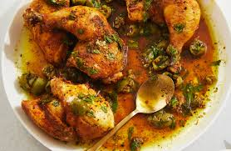
Future Work
Further investigate author’s effect on number of ratings
Scrape remaining recipes
Find better measure for number of steps

Slide 11
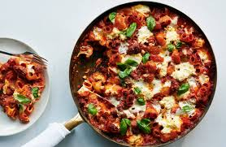
Future Work Given Access To All Data
Pull metrics for number of times a recipe site was shown in a search, visited, saved, commented on, and shared
Analyze user activity to find out if there are patterns in recipe views and ratings based on author and/or keyword tags

Slide 12
Questions?

Slide 13
Appendix

Slide 14
Top 10 Recipes By Rating
Recipe Name | # of Ratings | Agg Rating | Author | Est. Publish Date
No-Knead Bread | 13,705 | 5 | Mark Bittman | 2/23/15
Old-Fashioned Beef Stew | 10,920 | 5 | Molly O'Neill | 12/8/14
Creamy Macaroni and Cheese | 10,852 | 5 | Julia Moskin | 9/28/14
Marcella Hazan’s Bolognese Sauce | 10,474 | 5 | The New York Times | 5/31/15
Caramelized Shallot Pasta | 9,910 | 5 | Alison Roman | 2/2/20
Oven-Roasted Chicken Shawarma | 9,448 | 5 | Sam Sifton | 1/31/15
Chocolate Chip Cookies | 8,506 | 5 | David Leite | 9/28/14
Roasted Chicken Provençal | 8,173 | 5 | Sam Sifton | 4/4/15
Vinegar Chicken With Crushed Olive Dressing | 7,576 | 4 | Alison Roman | 9/30/19
Salted Chocolate Chunk Shortbread Cookies | 7,475 | 5 | Alison Roman | 1/14/18

